Slide 1
SWARM INTELLIGENCE

Slide 2

Swarm Intelligence?
Swarm intelligence (SI) is a branch of computational intelligence that discusses the collective behavior emerging within self-organizing societies of agents.
SI was inspired by the observation of the collective behavior in societies in nature such as the movement of birds and fish.
Due to their efficiency of solving complex problems such as finding the shortest path between their nest and food and source or organizing their nests.

Slide 3
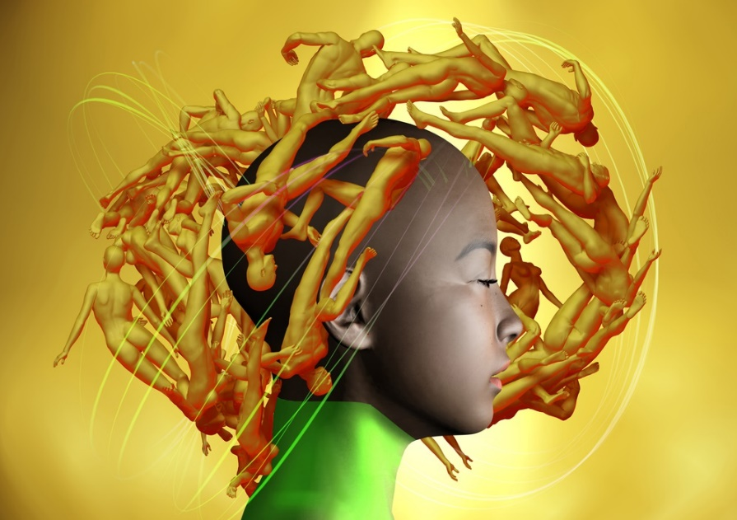
How do humans use swarm intelligence?
Human Swarming has been shown to enable groups to reach optimized decisions, prioritizations, and forecasts in significantly less time than traditional methods. In other words, thinking together in swarms makes groups smarter and faster.

Slide 4
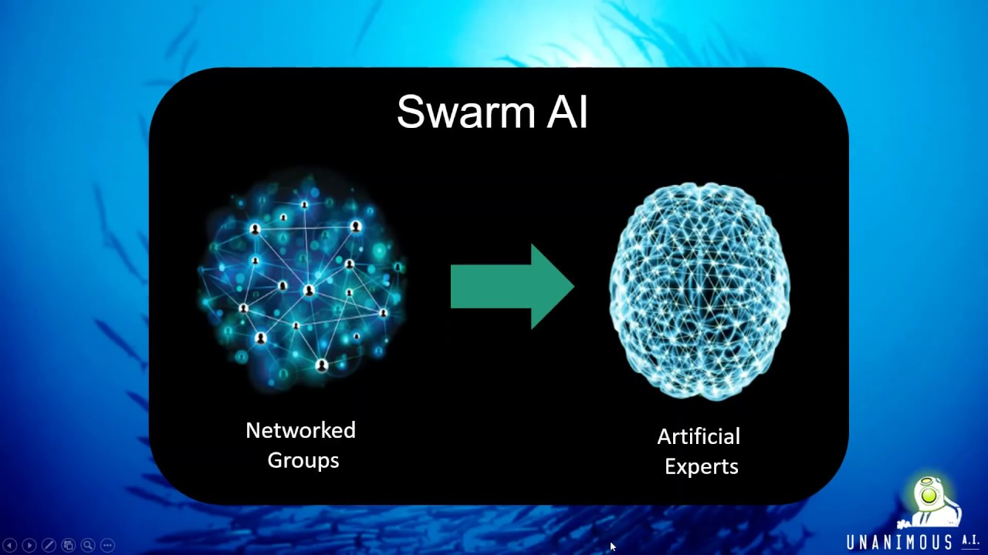
How is swarm intelligence used?
Swarm intelligence (SI) is one of the computational intelligence techniques which are used to solve complex problem. SI involves collective study of the individuals behavior of population interact with one another locally. Especially for biological systems nature often act as an inspiration.

Slide 5
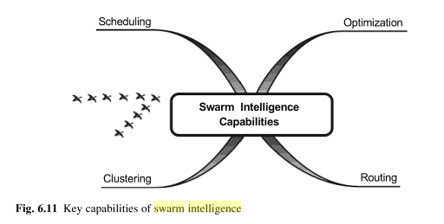
Main features of swarm!
One Million Heads, One Beautiful Mind.
Agents interacting locally with each other and the environment.
Agents follow simple rules.
Emergence of Itelligent, Collective, Self-organised, Global behaviour.
Decentralized and artificial or natural.
Very adaptive.

Slide 6
What is swarm intelligence in computer vision?
Swarm intelligence is an artificial or natural intelligence technique. It is based on studying collective behavior in decentralized and self-organized systems. Gerardo Benny and Joon Wang introduced swarm intelligence in 1989 in the context of cellular robotics systems.

Slide 7


Slide 8
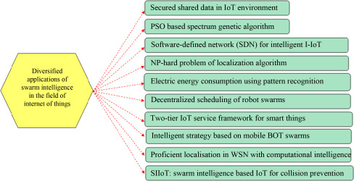

Slide 9
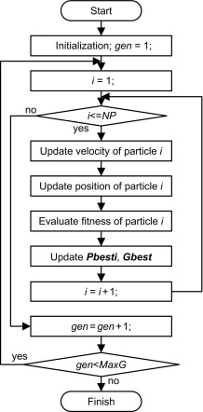
What is swarm algorithm used for?
These algorithms help in the enhancement of fitness functions in combinatorial and numerical optimization problems by discovering different combinations of values. Particle swarm optimization (PSO) was proposed in Kennedy and Eberhart (1995).

Slide 10
What are the application of swarm techniques in different domains?
Swarm based techniques have huge application domain covering multiple disciplines, which include,
power system,
fuzzy system,
forecasting,
bio-medicine,
sociological analysis,
image processing,
sound processing,
signal processing,
data analysis,
process modeling,
process controlling etc.

